Slide 1


Cryptography and Information Security Class 1 Mr. Jeremy Rasmussen, CISSP, CEH, PMP Spring Semester, 2015

Slide 2
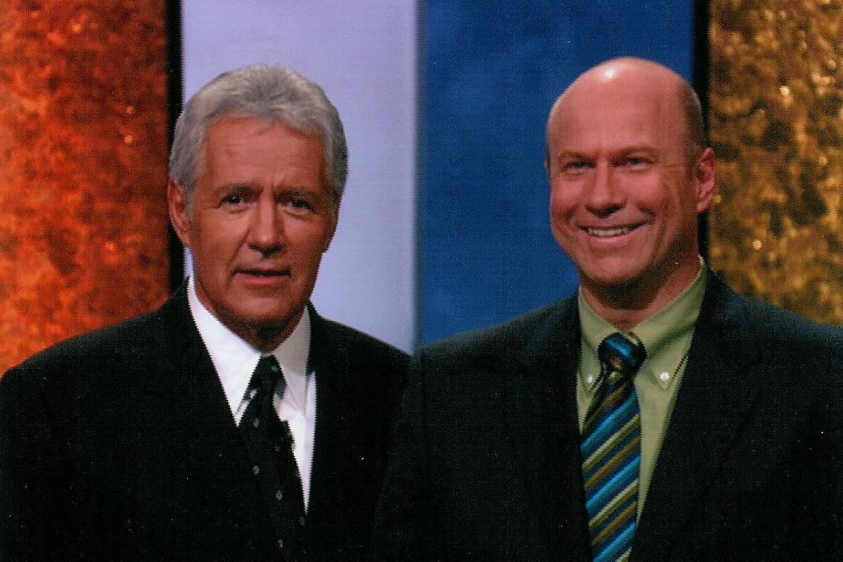
About me
Senior principal information security engineer at CACI International, Inc. ($4B/year, 15K employees)
Background in secure software and systems engineering.
B.S. Computer Science and M.S. Engineering Management from USF.
Adjunct professor at USF:
Cryptography & network security
Digital forensics and investigations
Ethical hacking
Mobile & wireless security
Embedded systems security
Started ethical hacking club
at USF: www.whitehatters.org

Slide 3
What is Capture the Flag (CtF)?
CtF is typically a multi-site, multi-team hacking contest in which a number of teams compete independently against each other. One popular way to do it:
Each team given a virtualized host image with a number of purposely vulnerable services.
Find vulnerabilities and fix them.
Use the vulnerabilities to compromise the other teams’ hosts.
Compromising a service allows a team to capture a “flag”

Slide 4
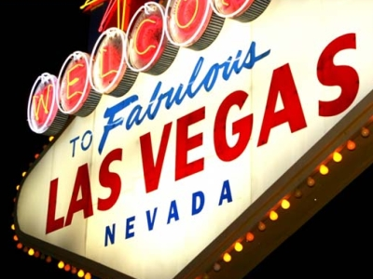
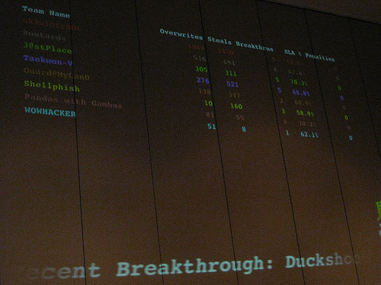
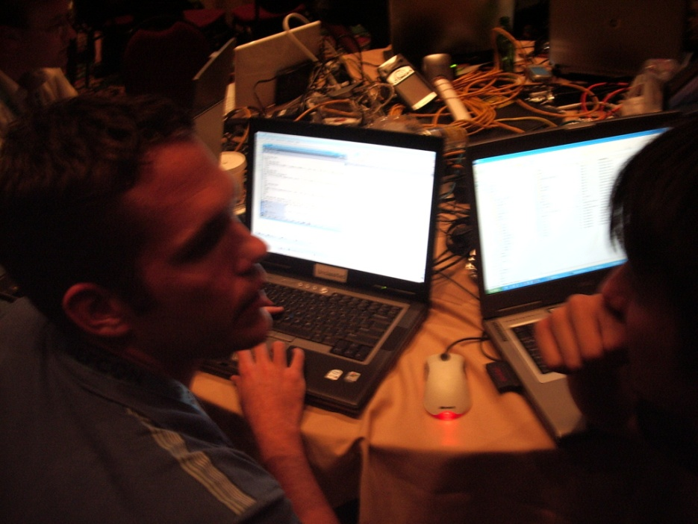
Defcon CtF

Slide 5
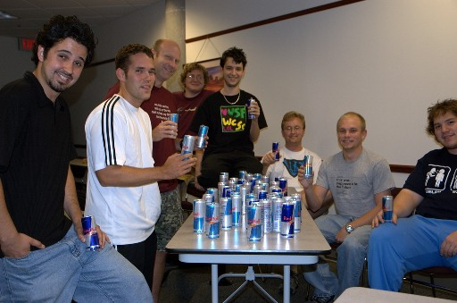
Whitehatters trophy case
1st, aCTF2.0, Defcon 14, 2006
1st, (Academic) DC3 Forensics, 2006
3rd, UC-Santa Barbara International CtF, 2006
2nd SE Collegiate Cyber Defense Comp., Kennesaw St. Univ, 2006
2nd, CIPHER2, Tech Univ. of Aachen, Germany, 2007
5th (of 150) Kenshoto DefCon CtF Qualifier, 2007
7th, DefCon 15 CtF finals, Las Vegas, 2007
Hosted intercollegiate CtF event “PWN 2007”
11th (of 400+), Kenshoto DefCon CtF Qualifier, 2008
Top 25, Defcon Quals, 2009-10.
4th, Defcon oCTF, 2010
8th (Qualified for finals), smpCTF, 2010
4th CSAW 2011
1st HackFortress, Defcon, 2011-13; Shmoocon 2013
Members/alumni helped run OpenCTF at Defcon, 2010-11; Defcon CTF finals 2013-15
Finalist (top 6); CSAW 2013
UC-Santa Barbara International CtF, 2013, 10th in the world and 2nd in the US.
72 out of 1061 teams, Defcon Quals 2014.
Recent history: https://ctftime.org/team/315
www.whitehatters.org

Slide 6
What I learned from CtF
You can learn a ton of stuff in a relatively short time.
However, to be the best, you can’t learn this stuff overnight.
It takes practice, just like any endeavor
You need a solid foundation of computer science.
“The best defense is information”…
- H.D. Moore of the Metasploit Project

Slide 7

The rules
No running with scissors, etc.
See syllabus

Slide 8
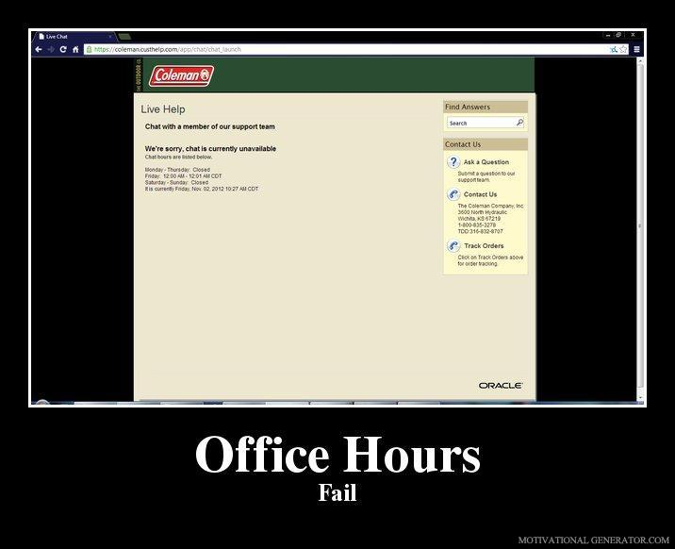
Class rules
See syllabus for office hours, schedule, grading, etc.

Slide 9
First, let’s ask a question: What are systems?

Slide 10
Who is Grace Hopper?
Before we answer that, let’s ask:

Slide 11
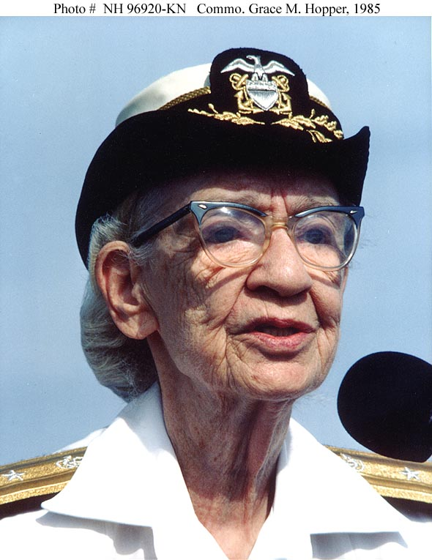
Rear Admiral Grace Murray Hopper
One of first modern software engineers
Helped developed COBOL
First called a programming bug a “bug”
Highest ranking female in the US Navy
Senior consultant to Digital Equipment Corporation
Watch Grace Hopper’s classic interview
on the Letterman Show:
https://www.youtube.com/watch?v=1-vcErOPofQ
“Life was simpler before World War II. After that, we had systems.”

Slide 12
What are systems?
Systems are:
Groups of devices or an organization forming a network especially for distributing something or serving a common purpose
Systems are increasingly:
Complex
Interactive
Emergent
Bug-ridden

Slide 13
Systems security
Because systems are complex, security for them cannot come through a single product (e.g., a firewall), but through a comprehensive process
Good systems security comes through a combination of “defense in depth”:
Prevention
Detection
Reaction

Slide 14
What is information security?
The protection of information against unauthorized disclosure, transfer, modification, or destruction, whether accidental or intentional.
Includes:
Internal factors
External factors
Natural disasters

Slide 15
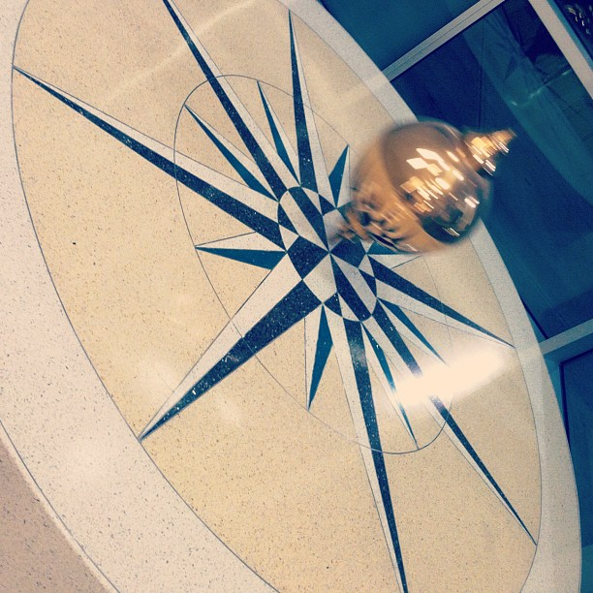
Information Security – the pendulum
25 years ago:
Primarily by physical/administrative protection (i.e, lock the door to the server room)
Centralized systems
Recent past:
Primarily by automated/computerized protection
Distributed systems/networks (e.g., local servers)
Now:
Primarily by automated/computerized protection
Centralized systems (e.g., the “cloud”)

Slide 16
What are attackers looking for?
In many cases, hackers’ ultimate goals are:
Stealing data from the target organizations
Business/engineering plans, intellectual property
Financial info
Credit card numbers
UserIDs/passwords to other systems
Installing back doors for further exploit

Slide 17
2013-14 top cybersecurity threats
Cyber mercenaries
Hacktivists
Mobile malware
Ransonmware
Watering hole attacks
End of privacy
Virtual currency attacks

Slide 18
Cyber Mercenaries
Advanced Persistent Threat malware campaigns like IceFog are high on the list.
They’ve most performed quick hit and run data theft in Asia.
The Chinese group ‘Hidden Lynx’, whose activities were first reported by researchers at Symantec in September ‘13, fall into this mercenary category. They were responsible for an attack on Massachusetts based cyber security firm Bit9 in 2013.
Chinese cyber theft of healthcare data in 2014 … why?

Slide 19
Hacktivists
Includes groups like Anonymous, targeting private and government computer systems, usually tied to a national protest going on at the time.
Usually DDoS (Distributed Denial of Service) attack.
One of biggest attacks directed at Spamhaus Project in March ’13.
It was estimated that the attack reached a throughput of 300 gigabits per second.
The secretive internet service provider, CyberBunker, was first suspected of launching the attack because they have been battling with Spamhaus for the past two years. And CyberBunker was blacklisted by Spamhaus a few weeks before the incident began.

Slide 20
Mobile malware
Some is just like desktop-based systems
Others – e.g., SMS -Trojan programs – a category exclusive to smartphones
Obad is multi-functional: it sends messages to premium rate numbers, downloads and installs other malware, uses Bluetooth to send itself to other devices and remotely performs commands at the console

Slide 21
Ransomware
Programs operate like a computer-specific ‘denial-of-service’ attack – they block access to a computer’s file system, or they encrypt data files stored on the computer.
CryptoLocker an example.
Normally the threats are for money and the malware does not infect a computer after the ransom is paid up. Once paid, the malware files are removed from the computer by the host and so far the cyber criminals behind the program have not reinfected computers after the ransom is paid.

Slide 22
Watering Hole
Watering-hole attack is used by cyber criminals as a replacement for spear-phishing and other methods.
One such attack was reported on a Tibetan refugee NGO called the Tibetan Homes Foundation. Their web site was compromised in order to distribute backdoors signed with stolen certificates. This was a classic case of a watering-hole attack – the cyber criminals had researched the preferred sites of their victims and compromised them in order to infect their computers.

Slide 23
End of privacy
A lot of people voluntarily give up their privacy on social media sites, but recent revelations have shown that the government (e.g., NSA) and big business (e.g., Google) are tracking and/or selling rich use profile data.
Snowden fallout:
Lavabit
Silent Circle
TrueCrypt

Slide 24
Virtual currency attacks
One way to be private is cash. Another way is virtual cash, or Bitcoin.
But Bitcoin is falling prey to malware writers. Brazilian cyber criminals are trying to impersonate Bitcoin exchange houses. Bitcoin mining botnets have also appeared, as well as malware designed to steal Bitcoin wallets.
Silk Road: illicit drug site running on Bitcoin.

Slide 25
What can we do about it?
The aforementioned issues and many others can be boiled down to a small number of concerns.
We call these concerns the essential security services that must be maintained in any system. They are…

Slide 26
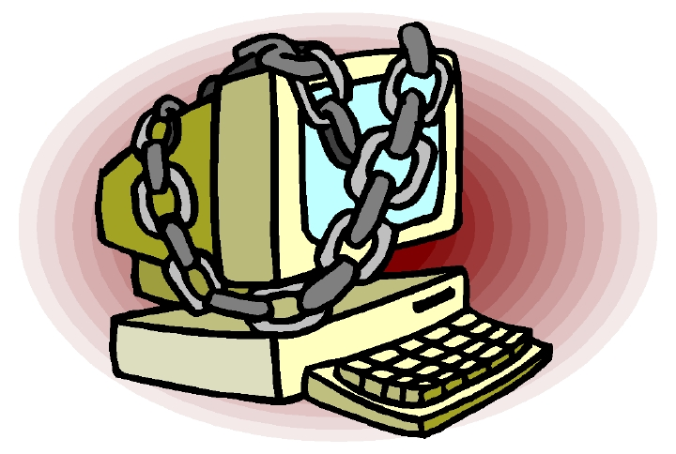
The Basic Security Services:
Confidentiality
Integrity
Availability
Authentication
Non-repudiation
Access Control (or Authorization)

Slide 27
Confidentiality
Definition: Assurance that information is not disclosed to unauthorized persons, processes, or devices.
Example breach of confidentiality: employee accesses company payroll system and views his boss’s and coworkers’ salary info.

Slide 28
Integrity
Definition: Condition existing when a system and its data are unchanged from their source and have not been accidentally or maliciously modified, altered, or destroyed.
Example breach of integrity: defaced e-commerce Web site.

Slide 29
Availability
Definition: Timely, reliable access to data and information services for authorized users.
Example breach of availability: A denial-of-service attack.

Slide 30
Authentication
Definition: Security measure designed to establish the validity of a transmission, message, or originator, or a means of verifying an individual’s authorization to receive specific categories of information.
Example breach of authentication: You receive an email claiming to be from someone other than its true sender.

Slide 31
Non-repudiation
Definition: Assurance the sender of data is provided with proof of delivery and the recipient is provided with proof of the sender’s identity, so neither can later deny having processed the data.
Example breach of non-repudiation: Customer claims he made a particular on-line purchase, and vendor has no means of proving otherwise.

Slide 32
Access control (or Authorization)
Definition: Limiting access to information system resources only to authorized users, programs, processes, or other systems.
Example breach of access control: a new account is created for low-level user that immediately has full administrative privileges on the system

Slide 33
Assignment 1
Read the Sophos 2015 Threat Report, and answer the following:
What do feel is the most dangerous threat among those discussed in the report? Why?
Which of the six Security Services is violated in this threat?
What are the countermeasures for this threat? Do you believe that they are effective? Why or why not?
Your write-up should not exceed two pages in length.
https://www.sophos.com/threat-center/medialibrary/PDFs/other/sophos-trends-and-predictions-2015.pdf

Slide 34
What are some of the threats to our valuable information assets?

Slide 35
Threats
Insiders (malicious or errors/omissions)
Outsiders (hackers, crackers, phreakers, phrackers, et al.)
Motivated by $$$, nationalistic causes, curiosity, greed, revenge, etc.
Natural disasters

Slide 36
The Internal Threat
Theft
Breach of privacy
Internet abuse
Email abuse
Harassment
Pornography
Pirated/unlicensed software
Malware
Disclosing company secrets

Slide 37
The External Threat
Denial of service attacks
Malware: Viruses, Worms, Trojan Horses
Web site vandalism
Web services attacks: XSS, SQL Injection
Corporate espionage
Phishing
Theft of transaction information
Financial fraud
Spam
Unauthorized use of resources
“Hackstortion”

Slide 38
The External Threat
Cyber crime has many similarities with physical crime (e.g., fraud, vandalism, extortion, etc.), but it is potentially much worse:
More widespread
Action at a distance
Technique propagation
Potentially greater effects/consequences…

Slide 39
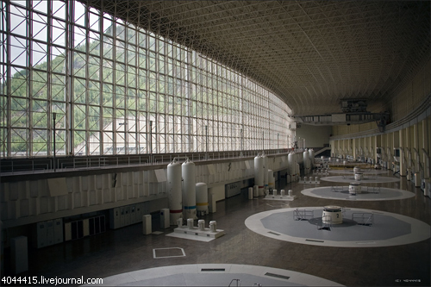
SCADA disaster: before
2009 at the Russian Sayano-Shushenskaya hydroelectric dam

Slide 40
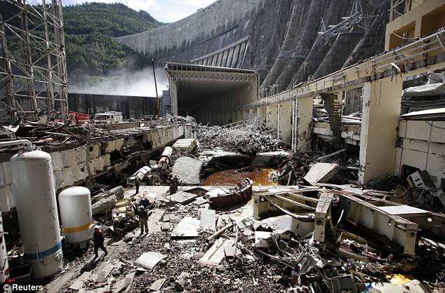
SCADA disaster: after

Slide 41
SCADA disaster: what happened?
New automatic control system--meant to slow or speed up turbines to match output to fluctuations in power demand
Incorrect software setting caused amplitude of machine's vibrations to increase to unsafe levels – Turbine 2 vibrated at four times the maximum limit
Result: 500-ton piece of machinery topped by a power generator blasted through the floor and shot 50 feet into the air before crashing back down, fragging everything in its path…
75 people killed, scores injured, 40 tons of oil spilled into Yenisei river

